Slide 1
[AI Theory&App] Introduction to Artificial Intelligence
Instructor: Hao-Shang Ma
Department Of Computer Science And Information Engineering, NTUST

Slide 2
Artificial Intelligence?
Artificial intelligence is the simulation of human intelligence processes by machines
Specific applications of AI include expert systems, natural language processing, speech recognition and computer vision

Slide 3
Artificial Intelligence?
Artificial Intelligence
Big Data
Statistics
Data Mining
Machine Learning
Deep Learning

Slide 4
Big Data
Big dataset property
Volume
Variety
Velocity
Veracity
Data Warehouse vs Data Lake

Slide 5
Statistics
A branch of mathematics and a field of study that deals with collecting, analyzing, interpreting, presenting, and organizing data.
Statistics vs Big Data
Statistics
Big Data
Small size
Cleaning
Static
Large size
Variety
Dynamic

Slide 6
Introduction to Data Mining

Slide 7
What is Data Mining
Knowledge Discovery from Data
Extraction of interesting, non-trivial, implicit, previously unknown and potentially useful patterns or knowledge from huge amount of data
Notes:
從大量數據中提取有趣的、重要的、隱含的、以前未知的和潛在有用的模式或知識

Slide 8
Data Mining Processes
Data collection
Data cleaning
Data integration
Data warehousing
Data selection
Pattern evaluation
Knowledge discovery
Information presentation
Decision making
Preprocessing
Exploration
Data Mining
Post processing

Slide 9
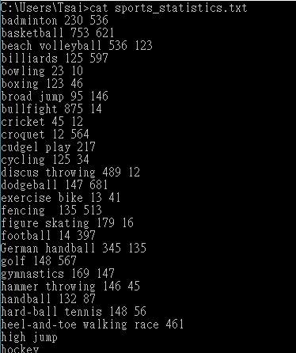
Information Presentation
Data Visualization
Make users understand the knowledge and make decision easily

Slide 10


Decision Making
Based on the evaluation results to decide the policy
Decision

Slide 11
General Types of Data Mining
Association rule mining
Sequential pattern mining
Classification
Clustering
etc.

Slide 12
Association Rules Mining
Mining implications between items
Frequent item sets
{A}, {B}, {C}, {D}, {B,C}, {A,B}, {A,D}, {B,D}, {A,B,D}
Strong rules
{A,D} → B(2/3)
B → C(2/3)
C → B(2/2)
Tid | Items
100 | A,B,D
200 | B,C,E
300 | A,D
400 | A,B,C,D
min_support = 2
min_conf = 2/3

Slide 13









Apriori Algorithm
$$C_{1}$$
$$L_{1}$$
Itemsets
{A}
{B}
{C}
{D}
{E}
itemsets | Sup
{A} | 3
{B} | 3
{C} | 2
{D} | 3
{E} | 1
Itemsets | Sup
{A} | 3
{B} | 3
{C} | 2
{D} | 3
$$1^{st} scan$$
Tid | Items
100 | A,B,D
200 | B,C,E
300 | A,D
400 | A,B,C,D
$$C_{2}$$
Infrequent
Itemsets
pruning
Itemsets
{A,B}
{A,C}
{A,D}
{B,C}
{B,D}
{C,D}
$$L_{2}$$
Itemsets | Sup
{A,B} | 2
{A,C} | 1
{A,D} | 3
{B,C} | 2
{B,D} | 2
{C,D} | 1
Itemsets | Sup
{A,B} | 2
{A,D} | 2
{B,C} | 3
{B,D} | 2
$$2^{nd} scan$$
Database
$$C_{3}$$
$$L_{3}$$
Itemsets
{A,B,D}
$$3^{rd} scan$$
Itemsets | Sup
{A,B,D} | 2
Itemsets | Sup
{A,B,D} | 2

Slide 14

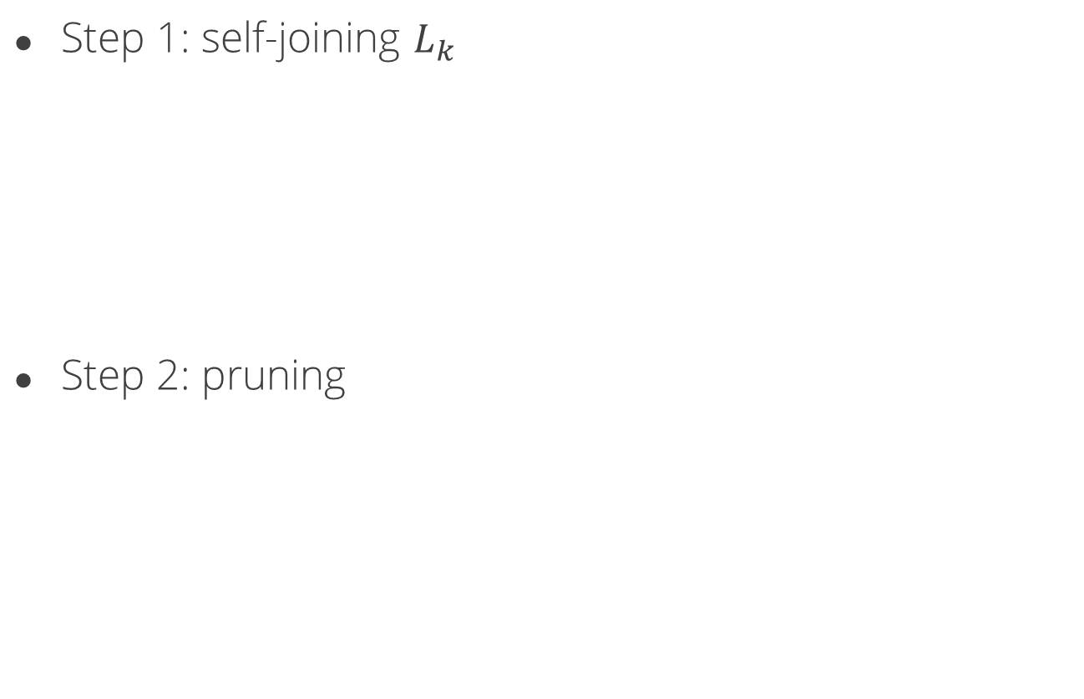

Candidate Generation
Step 1: self-joining $L_{k}$
Step 2: pruning
Itemsets | Sup
{A,B} | 2
{A,D} | 2
{B,C} | 3
{B,D} | 2
$$\left\{A,B\right\}∪\left\{A,D\right\}=\{A,B,D\}$$
Itemsets
{A,B,D}
{B,C,D}
$$\left\{B,C\right\}∪\left\{B,D\right\}=\{B,C,D\}$$
Itemsets
{A,B,D}
{B,C,D}
{C,D} is infrequent
Itemsets | Sup
{A,B,D} | 2

Slide 15
Downward Closure Property
Any subset of a frequent itemset must be frequent
If there is any itemset which is infrequent, its superset should not be frequent
Itemsets | Sup
{A,B} | 2
{A,D} | 2
{B,C} | 3
{B,D} | 2
Itemsets | Sup
{A} | 3
{B} | 3
{C} | 2
{D} | 3
Itemsets | Sup
{A,B,D} | 2

Slide 16
Sequential Pattern Mining
Mining sequential implications between items
SID | Sequences
100 | <(1) (2,5) (3) (4)>
200 | <(1) (3) (4) (2),(3,5)>
300 | <(1,3,5) (4) (2) (3)>
400 | <(1) (3) (5)>
500 | <(4) (3,5,6)>
min_support = 2
Some frequent sequential patterns
{1,4,2,3},{1,3,5},{4,5}

Slide 17
The Steps of Apriori-like Algorithm
1. Sort phase
Sort the database
Customer id as the primary key and time as the second key
2. Litemset phase
Count the frequency of the itemset
The fraction of customers who bought the itemset

Slide 18
The Steps of Apriori-like Algorithm
3. Transformation phase
Transform each tx to all litemsets in the form of
C01: <(1,5) (2) (3) (4)>
C02: <(1) (3) (4) (3,5)>
C03: <(1) (2) (3) (4)>
C04: <(1) (3) (5)>
C05: <(4) (5)>

Slide 19
itemset | Count
1 | 4
2 | 3
3 | 4
4 | 4
5 | 4
6 | 1
{2,5} | 1
{1,3} | 1
{1,5} | 1
{3,5} | 3
{1,3,5} | 1
{5,6} | 1
{3,6} | 1
{3,5,6} | 1
SID | Sequences
100 | <(1) (2,5) (3) (4)>
200 | <(1) (3) (4) (2),(3,5)>
300 | <(1,3,5) (4) (2) (3)>
400 | <(1) (3) (5)>
500 | <(4) (3,5,6)>

Slide 20
SID | Sequences
100 | <(1) (2,5) (3) (4)>
200 | <(1) (3) (4) (2),(3,5)>
300 | <(1,3,5) (4) (2) (3)>
400 | <(1) (3) (5)>
500 | <(4) (3,5,6)>
itemset | Count | New ID
1 | 4 | A
2 | 3 | B
3 | 4 | C
4 | 4 | D
5 | 4 | E
{3,5} | 3 | F
SID | Sequences
100 | <(A) (B,E) (C) (D)>
200 | <(A) (C) (D) (B),(C,E,F)>
300 | <(A,C,E,F) (D) (B) (C)>
400 | <(A) (C) (E)>
500 | <(D) (B,E,F)>

Slide 21
The Steps of Apriori-like Algorithm
4. Mining phase
Apriori-like algorithm
5. Maximal phase
Find the maximum patterns

Slide 22
2-Itemset | count
A,B | 3
A,C | 4
A,D | 3
A,E | 3
A,F | 2
B,A | 0
B,C | 3
B,D | 1
B,E | 1
B,F | 1
C,A | 0
C,B | 2
C,D | 3
C,E | 2
C,F | 0
2-Itemset | count
D,A | 0
D,B | 3
D,C | 2
D,E | 2
D,F | 2
E,A | 0
E,B | 1
E,C | 2
E,D | 2
E,F | 0
F,A | 0
F,B | 1
F,C | 1
F,D | 1
F,E | 0
SID | Sequences
100 | <(A) (B,E) (C) (D)>
200 | <(A) (C) (D) (B),(C,E,F)>
300 | <(A,C,E,F) (D) (B) (C)>
400 | <(A) (C) (E)>
500 | <(D) (B,E,F)>
3-itemset | Count
A,B,C | 3
A,C,D | 2
D,B,C | 1
A,D,B | 2

Slide 23
2-Itemset | count
A,B | 3
A,C | 4
A,D | 3
A,E | 3
B,C | 3
C,D | 3
D,B | 3
SID | Sequences
100 | <(A) (B,E) (C) (D)>
200 | <(A) (C) (D) (B),(C,E,F)>
300 | <(A,C,E,F) (D) (B) (C)>
400 | <(A) (C) (E)>
500 | <(D) (B,E,F)>
3-itemset | Count
A,B,C | 3
A,C,D | 2
D,B,C | 1
A,D,B | 2

Slide 24
Itemset | count
A,B | 3
A,C | 4
A,D | 3
A,E | 3
B,C | 3
C,D | 3
D,B | 3
A,B,C | 3
itemset | Count | New ID
1 | 4 | A
2 | 3 | B
3 | 4 | C
4 | 4 | D
5 | 4 | E
{3,5} | 3 | F
Frequent patterns: {1,2}, {1,3}, {1,4}, {1,5}, {2,3}, {3,4}, {4,2}, {1,2,3}

Slide 25
Classification
Determine the label of data given some observations
Name | Education | Salary | Job | Seniority | Buy car
Allen | Ph.D | High | Engineer | Medium | Yes
Bubble | College | Low | Worker | Medium | No
Chris | Senior high | Medium | Worker | Medium | No
Dustin | Master | Medium | Engineer | Long | Yes
Elan | Ph.D | High | Professor | Long | Yes
Frank | College | High | Sport player | Long | Yes
George | Master | Medium | Engineer | Short | No
(Education >= college) & (salary >= Medium) => buy car

Slide 26


Decision Tree
education
>college
=college
<college
Seniority
No
>=medium
salary
<medium
>=medium
<medium
Yes
No
Yes
No

Slide 27
Clustering
Determine which items should be similar to one another within a group

Slide 28
K-means Algorithm
Until the process
is convergent

Slide 29
Introduction to Machine Learning

Slide 30
The Origins of Machine Learning
How can computers learn to solve problems without being explicitly programmed?
-----Arthur Lee Samuel, 1959
The answer is: Machine Learning
Arthur Lee Samuel, Some Studies in Machine Learning Using the Game of Checkers, IBM Journal of Research and Development. 3, 1959

Slide 31
What is Machine Learning
Machine learning is a field of computer science that gives computer systems the ability to "learn," i.e., progressively improve performance on a specific task, with data but without being explicitly programmed.
Learn knowledges from data

Slide 32
General Types of Machine Learning
Supervise Learning
Classification problems
Unsupervised Learning
Clustering problems
Text mining
Semi-supervised learning
The classification problem with some missing labels
The clustering problem with some labels

Slide 33
Some Special Types of Machine Learning
Reinforcement Learning
alphaGo
alphaGoZero
Interactive learning
Transfer learning

Slide 34
Supervised Learning
Learning from some labeled data
We have the answers of training data
?
?

Slide 35
Support Vector Machine
projection
Find hyperplane
Find better one

Slide 36
Find The Best Hyperplane
Find the hyperplane with the largest margin
m: margin
m

Slide 37
Unsupervised Learning
Learning on the un-labeled data
We do not have the answer of training data
?
?
?
?

Slide 38

Similar to Clustering
A word in the documents
Clustering algorithms
Documents
Could be a topic in the documents

Slide 39
Semi-supervised Learning
Learning on partly-labeled data
We have only some answers for training data
?
?
?
?

Slide 40
How to Add Labels for Un-labeled Data
Continuity assumption
The nearby data might have the same labels
Cluster assumption
The data in the same cluster might have the same labels
Manifold assumption
The data lie approximately on a manifold of much lower dimension than the input space

Slide 41


Reinforcement Learning
Learning from rewards
Training our kids
Action
Agent
Environment
State, Reward

Slide 42
The Example
 |  |  |  | treasure
 |  |  |  | monster

Slide 43
How Do I Decide Next Step
 |  |  |  | treasure
 |  |  |  | monster
？
？
Go back

Slide 44
1st Choice
 |  |  |  | treasure
 |  |  |  | monster

Slide 45
Yeah!!
I got the treasure
 |  |  |  | treasure
 |  |  |  | monster

Slide 46
2nd Choice
 |  |  |  | treasure
 |  |  |  | monster

Slide 47
 |  |  |  | treasure
 |  |  |  | monster
Ah NO~~
It’s a monster!!!

Slide 48
The Best Action in Each Step

Slide 49

Interactive Learning
Human can give feedbacks to machine to help machine train a better model
input
output
Models
Error and human feedbacks

Slide 50
Transfer Learning
Transfer some knowledge from trained models to new models
Transfer
parameters & structures
Help for training
Models
For domain A
input
output
Models
For domain B

Slide 51
General Machine Learning Steps
Data preparation
Preprocessing
Model development
Determine your objective functions
Exploration
Split data into training set and testing set
Determine the learning types
Training
Testing
Solve the optimization problem you designed or fit your model with data
Test the model performance on the testing data

Slide 52


Cross Validation
training
validation
divide
.
.
.
Training data
Validate 10 times
90% of training data
10% of training data
Training
Validation

Slide 53

Quality Measurement
Accuracy
$ACC=\frac{TP+TN}{P+N}$
Precision
$Pre=\frac{TP}{PP}$
Recall
Rec$=\frac{TP}{P}$
F-measure
$F1=2×\frac{Pre×Rec}{Pre+Rec}$
 | Positive (P) | Negative (N)
Predict Positive (PP) | True Positive (TP) | False Positive (FP)
Predict Negative (PN) | False Negative (FN) | True Negative (FN)
condition
prediction

Slide 54
Compare with Data Mining
Data Mining
Machine Learning
Data collection
Data cleaning
Data integration
Data warehousing
Data selection
Pattern evaluation
Knowledge discovery
Information presentation
Decision making
Data collection
Data cleaning
Data integration
Data warehousing
Data selection
Model design
Model training & testing
Information presentation
Decision making

Slide 55
Introduction to Deep Learning

Slide 56

Deep Learning
Using some deep (with many layers) models to solve the problem
Each layer can represent different features
We can learn more knowledge from input data
…
output
input
$$hidden layer$$

Slide 57
The Strong Points of Deep Learning
Without deep learning
With deep learning
Word
counts
Topics
Models
Articles
Articles
TF-IDF
value
Deep
Learning
Models

Slide 58


The Strong Points of Deep Learning
…
output
input
$$1^{st} layer$$
$$n^{th} layer$$
Represent different features

Slide 59
















The Weak Points of Deep Learning
$$w_{cd}$$
$$w_{xy}$$
$$w_{11}$$
$$w_{ab}$$
$$w_{n1}$$
$$w_{12}$$
$$w_{n2}$$
$$w_{13}$$
$$w_{n3}$$
$$w_{mn}$$
…………
…
…………
$$w_{yz}$$
$$w_{st}$$
$$w_{gh}$$
output
input
$$w_{ef}$$
$$1^{st} layer$$
$$n^{th} layer$$
Lots of parameters to be trained
Need lots of data to train a good model

